Slide 1
View Serializability

Slide 2
If a given schedule is found to be view equivalent to some serial schedule, then it is called as a view serializable schedule.
View Equivalent Schedules-
Consider two schedules S1 and S2 each consisting of two transactions T1 and T2.
Schedules S1 and S2 are called view equivalent if the following three conditions hold true for them-

Slide 3
Condition-01:
For each data item X, if transaction T_{i} reads X from the database initially in schedule S1, then in schedule S2 also, T_{i} must perform the initial read of X from the database.
“Initial readers must be same for all the data items”.
Condition-02:
If transaction T_{i} reads a data item that has been updated by the transaction T_{j} in schedule S1, then in schedule S2 also, transaction T_{i} must read the same data item that has been updated by the transaction T_{j.}
“Write-read sequence must be same.”.
Condition-03:
For each data item X, if X has been updated at last by transaction T_{i} in schedule S1, then in schedule S2 also, X must be updated at last by transaction T_{i}.
“Final writers must be same for all the data items”.

Slide 4
Checking Whether a Schedule is View Serializable Or Not-
Method-01:
Check whether the given schedule is conflict serializable or not.
If the given schedule is conflict serializable, then it is surely view serializable. Stop and report your answer.
If the given schedule is not conflict serializable, then it may or may not be view serializable. Go and check using other methods.
All conflict serializable schedules are view serializable.
All view serializable schedules may or may not be conflict serializable.
Method-02:
Check if there exists any blind write operation.
(Writing without reading is called as a blind write).
If there does not exist any blind write, then the schedule is surely not view serializable. Stop and report your answer.
If there exists any blind write, then the schedule may or may not be view serializable. Go and check using other methods.
No blind write means not a view serializable schedule.

Slide 5
Method-03:
In this method, try finding a view equivalent serial schedule.
By using the above three conditions, write all the dependencies.
Then, draw a graph using those dependencies.
If there exists no cycle in the graph, then the schedule is view serializable otherwise not.

Slide 7
Example:
S
S’
T1 T2 T3
R(A)
W(A)
W(A)
W(A)
T1 T2 T3
R(A)
W(A)
W(A)
W(A)

Slide 8
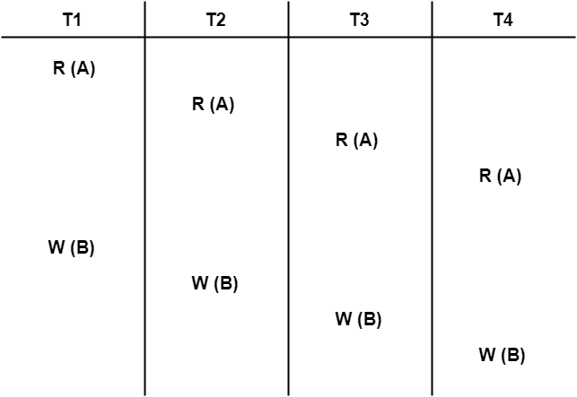
Problem-01:
Check whether the given schedule S is view serializable or not-

Slide 9
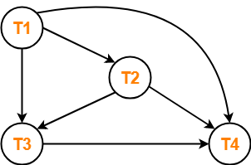
Clearly, there exists no cycle in the precedence graph.
Therefore, the given schedule S is conflict serializable.
Thus, we conclude that the given schedule is also view serializable.

Slide 10
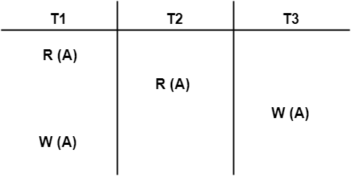
Problem-02:
Check whether the given schedule S is view serializable or not-

Slide 11
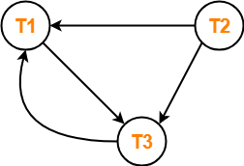
Clearly, there exists a cycle in the precedence graph.
Therefore, the given schedule S is not conflict serializable.
Now,
Since, the given schedule S is not conflict serializable, so, it may or may not be view serializable.
To check whether S is view serializable or not, let us use another method.
Let us check for blind writes.

Slide 12
Checking for Blind Writes-
There exists a blind write W₃ (A) in the given schedule S.
Therefore, the given schedule S may or may not be view serializable.
Now,
To check whether S is view serializable or not, let us use another method.
Let us derive the dependencies and then draw a dependency graph.
Drawing a Dependency Graph-
T1 firstly reads A and T3 firstly updates A.
So, T1 must execute before T3.
Thus, we get the dependency T1 → T3.
Final updation on A is made by the transaction T1.
So, T1 must execute after all other transactions.
Thus, we get the dependency (T2, T3) → T1.
There exists no write-read sequence.
Now, let us draw a dependency graph using these dependencies-

Slide 13
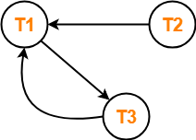
Clearly, there exists a cycle in the dependency graph.
Thus, we conclude that the given schedule S is not view serializable.

Slide 14
Problem-04:
Check whether the given schedule S is view serializable or not. If yes, then give the serial schedule.
S : R₁(A) , W₂(A) , R₃(A) , W₁(A) , W₃(A)
Notes:
View Serializable

Slide 15
Checking Whether S is Conflict Serializable Or Not-
Step-01:
List all the conflicting operations and determine the dependency between the transactions-
R₁(A) , W₂(A) (T₁ → T₂)
R₁(A) , W₃(A) (T₁ → T₃)
W₂(A) , R₃(A) (T₂ → T₃)
W₂(A) , W₁(A) (T₂ → T₁)
W₂(A) , W₃(A) (T₂ → T₃)
R₃(A) , W₁(A) (T₃ → T₁)
W₁(A) , W₃(A) (T₁ → T₃)
Step-02:
Draw the precedence graph-

Slide 16
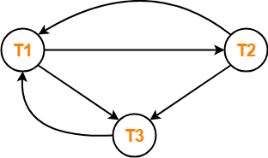
Clearly, there exists a cycle in the precedence graph.
Therefore, the given schedule S is not conflict serializable.

Slide 17
Checking for Blind Writes-
There exists a blind write W₂ (A) in the given schedule S.
Therefore, the given schedule S may or may not be view serializable.
Now,
To check whether S is view serializable or not, let us use another method.
Let us derive the dependencies and then draw a dependency graph.

Slide 18
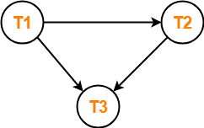
Drawing a Dependency Graph-
T1 firstly reads A and T2 firstly updates A.
So, T1 must execute before T2.
Thus, we get the dependency T1 → T2.
Final updation on A is made by the transaction T3.
So, T3 must execute after all other transactions.
Thus, we get the dependency (T1, T2) → T3.
From write-read sequence, we get the dependency T2 → T3
Clearly, there exists no cycle in the dependency graph.
Therefore, the given schedule S is view serializable.
The serialization order T1 → T2 → T3.

Slide 19
